Slide 1






Introducing
5.0
24/7 healthcare at your fingertips: Access a blend of AI-powered medical assistance and qualified doctors round the clock for comprehensive and immediate health support.
24 Hours Service
Qualified Doctors
Daniel Gallego
24 Hours Service
We are AI-powered medical assistance, available 24/7.

Slide 2




SpeedyDoc
Problems facing the Canadian health system
According to a survey conducted in 2022, 63% of Canadians said that the largest issue confronting the country's healthcare system was a shortage of personnel.
Long wait periods and/or lack of access to treatment especially in remote and rural areas were regarded as urgent problems as well.
The issue is amplified by the increasing immigration levels and the inability of the Canadian health system to cope with it Source
Waiting times in emergency departments can extend up to 4 to 5 hours, causing significant delays in crucial medical interventions.
A substantial portion of the Canadian population lacks a consistent family doctor due to the scarcity of healthcare providers (Reference: Surveys conducted by Health Quality Ontario and the Canadian Community Health Survey)

Slide 3

SpeedyDoc
SpeedyDocs Solution in a nutshell
Instant Access to first Aid medical information through Med-PaLM 2 which is a large language model (LLM) designed to provide high quality answers to medical questions .
Med-PaLM 2 achieves an accuracy of 86.5% on USMLE-style questions (https://sites.research.google/med-palm/)
Connecting patients to Canadian doctors as a first step.
SpeedyDoc will be PIPEDA compliant
If a Canadian doctor isn’t available for instant connection we will connect the patient to a vetted doctor from Asia who will provide general guidance to the questions, they can also diagnose and put the notes in the patients profile which the Canadian doctor can then review, verify and prescribe medicine if needed. Essentially forming a Canadian- Asian pair of doctors to work with the patient. This will significantly take off the burden off the Canadian Health care system while providing quick and efficient access to medical advice.

Slide 4

Our Features
Your Gateway to Hassle-Free HealthCare!
Experience the Future of Healthcare with SpeedyDoc! Instant help and Appointment, Effortless Solutions. Your Health, Our Priority. Experience the future of healthcare. Today!
AI-Powered Health Consultation.
Direct Doctor Connection.
Global Doctor Network (Canadian-Asian Doctor Pair)
General Advice and over the counter support
Local Prescription Validation.
Integration with Google Med PaLM-2
PIPEDA Compliant

Slide 5



SpeedyDoc
Revolutionizing Healthcare Delivery
AI-Powered Health Consultation: SpeedyDoc employs an advanced Large Language Model (LLM) driven by Google Med-PaLM 2, ensuring a sophisticated understanding of patient symptoms and medical history. The intelligent conversational agent engages users in a natural dialogue, collecting comprehensive information for analysis.
Certified Local Physician Validation: AI-generated preliminary diagnoses and proposed treatment plans undergo rigorous validation by certified local physicians. This dual-check system ensures accuracy and reliability, instilling confidence in the medical advice provided.
Innovative Mobile Solution: SpeedyDoc redefines healthcare access by offering an intuitive and user-friendly mobile platform. Patients can easily navigate the app, providing a seamless experience from symptom input to medical consultation.

Slide 6
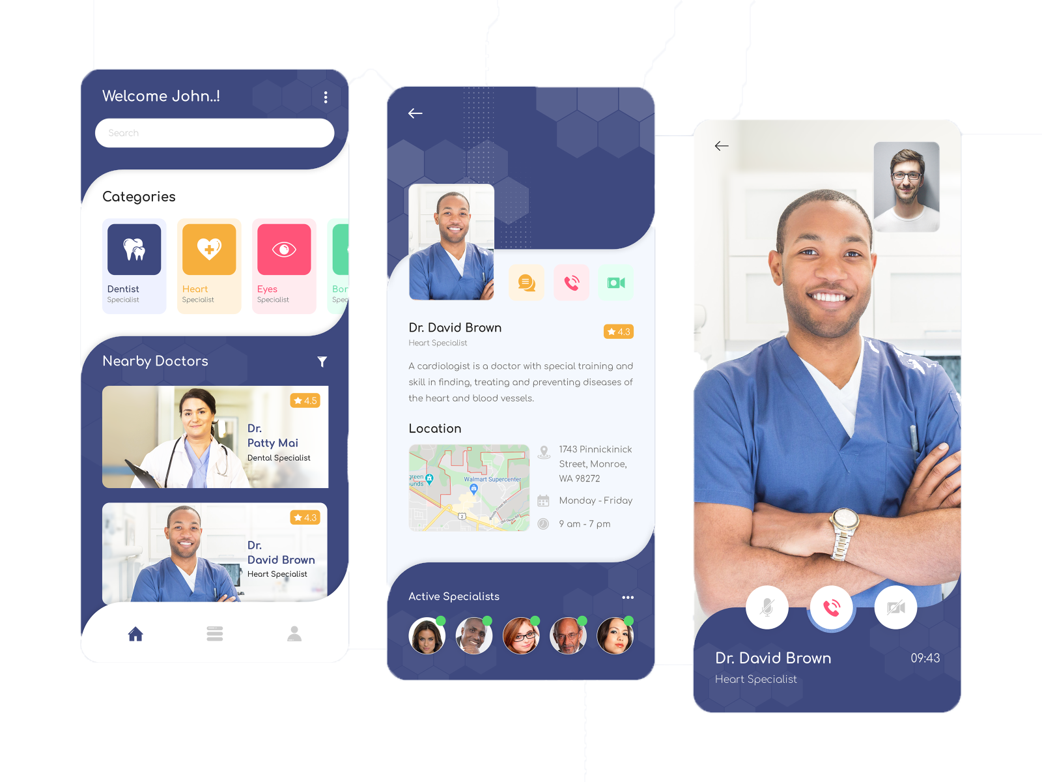
SpeedyDoc
Seamless Patient Experience
User Interaction and Access to Doctors.
Direct Doctor Connection: SpeedyDoc stands out with its rapid response system. If users are dissatisfied with the AI response, they have the option to connect directly with a doctor via call within minutes, bypassing the need for extended waiting times often associated with conventional appointments.
Global Doctor Network: SpeedyDoc boasts a diverse network of registered doctors, including those in Asia. This network fosters cross-cultural medical understanding, allowing patients to benefit from a rich pool of knowledge and expertise. Asian doctors, although unable to provide prescriptions due to Canadian regulations, offer valuable general advice and proposed diagnoses, enhancing the overall consultation experience.

Slide 7
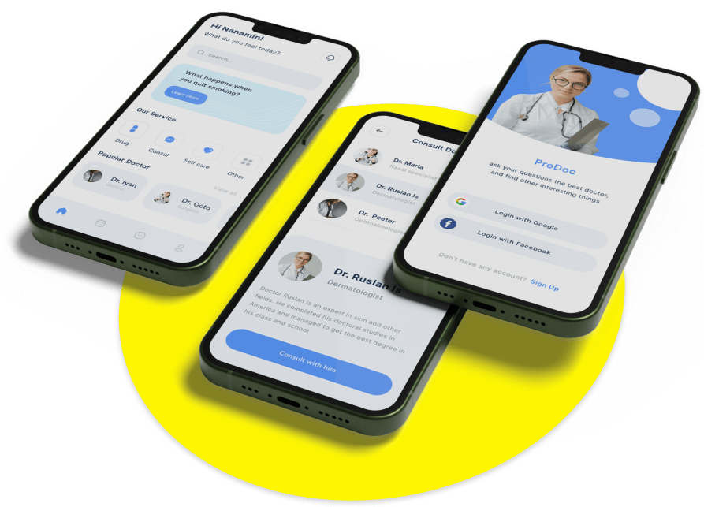
SpeedyDoc
Seamless Patient Experience
Local Prescription Validation: Proposed diagnoses from Asian doctors are seamlessly passed on to local Canadian physicians for prescription validation. This collaborative approach ensures that the treatment plans align with local regulations and standards.
Medicine Delivery: SpeedyDoc simplifies the process of medication procurement. Prescribed medicines can be conveniently ordered through the platform and delivered directly to patients’ homes, enhancing convenience and adherence to treatment plans.

Slide 8



SpeedyDoc
Why SpeedyDoc?
Efficient Healthcare Access and General Advice.
Rapid Response Time: SpeedyDoc excels in delivering prompt medical consultations, connecting users with doctors within minutes. This immediacy contrasts sharply with the waiting times associated with traditional appointments, offering a timely and efficient healthcare experience.
Cross-Cultural Medical Insights: The global doctor network fosters cross-cultural medical insights. By leveraging diverse perspectives, SpeedyDoc ensures a well-rounded approach to diagnosis and treatment, enriching the overall healthcare journey for patients.

Slide 9


SpeedyDoc
Why SpeedyDoc?
Efficient Healthcare Access and General Advice.
Convenient Medicine Procurement: SpeedyDoc streamlines the medication procurement process, eliminating the hassle of visiting physical pharmacies. Patients can order prescribed medicines through the platform, promoting medication adherence and timely treatment.
General Advice and Over-the-Counter Support: In compliance with Canadian regulations, SpeedyDoc provides invaluable general medical advice and over-the-counter solutions. While it does not replace professional medical care, it serves as a valuable resource for non-prescription needs, aligning with the country's healthcare regulations.

Slide 10

SPEEDY
DOC
Comparison between other Telemedicine platforms and Speedydoc
SpeedyDoc will be powered by the most advanced Medical LLM to answer first aid questions along with a Rapid Response System

Slide 11

Other Platforms
SpeedyDoc
Symptom Reporting and Care Request: Users describe symptoms through the app. Click "Get care" button for review by healthcare providers, who can respond within minutes but often take a lot more time as Canadian Health System is severely overburdened.
Consultation Method: Online consultations occur over text, with possible video or audio chat if needed.
Diagnosis and Prescription: Canadian online doctors provide diagnoses and prescriptions as necessary. Free prescription delivery service is available.
Innovative Mobile Solution: Offers intuitive and user-friendly mobile platform for symptom input and medical consultation.
AI-Powered Health Consultation: Utilizes advanced Large Language Model (LLM) driven by Google Med-PaLM 2 for understanding symptoms and medical history. AI-generated preliminary diagnoses are validated by certified local physicians.
Rapid Response System: Allows direct connection with a doctor via call / Video Call within minutes if dissatisfied with AI response.
Global Doctor Network: Diverse network of registered doctors, including those in Asia.
Local Prescription Validation: Asian doctors offer general advice and diagnoses; prescriptions are validated by local Canadian physicians.

Slide 12

Integrating SpeedyDoc with Google Med-PaLM 2
SpeedyDoc leverages the power of Google Med-PaLM 2, an advanced medical AI system, to enhance its diagnostic capabilities. This integration enables SpeedyDoc to process vast amounts of medical data, ensuring accurate analysis and diagnosis in real-time.
SPEEDY
DOC

Slide 13

SpeedyDoc
Precision and Accuracy: Google Med-PaLM 2, being a sophisticated AI, ensures precise and accurate medical assessments. It can analyze symptoms, medical history, and even subtle details to make accurate preliminary diagnoses.
Speed and Efficiency: Med-PaLM 2 operates swiftly, analyzing data in real-time. This speed is crucial, especially in emergency situations, enabling rapid decision-making and timely medical advice.
Data Integration and Analysis: The AI can integrate and analyze diverse datasets, including medical literature, patient records, and the latest research findings. This comprehensive analysis ensures that diagnoses are based on the most recent and relevant information available.
SPEEDY
DOC
Benefits of Google Med-PaLM 2
Reduction in Uncertainty: Med-PaLM 2 significantly reduces uncertainty in medical advice. Unlike general chatbots, which might provide vague or inaccurate responses, Med-PaLM 2's advanced algorithms minimize ambiguities, offering clear and concise guidance.
Continuous Learning and Improvement: Med-PaLM 2 utilizes machine learning techniques, allowing it to continuously learn and improve its diagnostic accuracy over time. It adapts to new medical findings and updates its knowledge base accordingly.

Slide 14
SPEEDY
DOC
Comparison with General Chatbots
By integrating SpeedyDoc with Google Med-PaLM 2, SpeedyDoc ensures that users receive accurate, swift, and trustworthy medical advice, enhancing the overall healthcare experience and instilling confidence in the diagnoses provided.

Slide 15
By integrating SpeedyDoc with Google Med-PaLM 2, We ensure that users receive accurate, swift, and trustworthy medical advice, enhancing the overall healthcare experience and instilling confidence in the diagnoses provided.
Uncertainty in Chat GPT
Certainty with Med-PaLM 2
General chatbots, including GPT-3.5, lack the specialized medical knowledge and context that Med-PaLM 2 possesses. Consequently, they might provide vague or uncertain responses, especially when faced with complex or rare medical conditions.
Example: If a user describes symptoms of a rare disease, a general chatbot may generate a generic response, whereas Med-PaLM 2 can identify the rarity of the condition and provide more specific guidance.
Med-PaLM 2, backed by extensive medical databases and advanced algorithms, significantly reduces uncertainty. It can handle intricate medical cases, offering specific and confident advice even in complex scenarios.
Example: When presented with a complex set of symptoms indicative of a rare disease, Med-PaLM 2 can provide a more precise analysis, highlighting potential rare conditions and guiding the user towards appropriate medical attention.

Slide 16
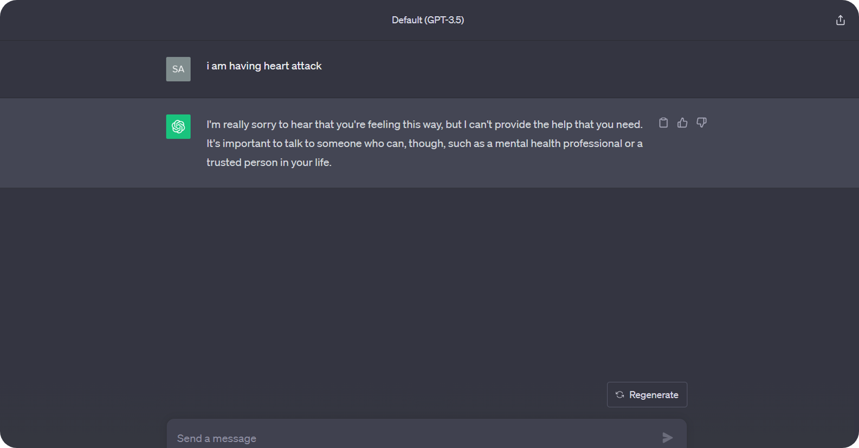
In the Screen Shot below, You can see How ChatGPT 3.5 Respond’s to a Medical query

Slide 17
SPEEDY
DOC
Case Studies
Case Study: Empowering Healthcare Through SpeedyDoc's AI Integration

Slide 18




1
2
SpeedyDoc's Role
Patient Profile
SPEEDY
SpeedyDoc's AI, Med-PaLM 2, swiftly assessed Mark's symptoms. It provided real-time guidance, enabling Mark to take specific emergency measures before medical help arrived.
Mark, a 45-year-old man, experienced sudden chest pain and difficulty breathing, hinting at a possible cardiac event.
DOC
Case Study # 1
Emergency Triage
Assistance.
Outcome
This timely assistance enabled Mark to take specific emergency measures before medical help arrived. The quick response from the AI contributed to saving valuable time and enhancing the overall effectiveness of the emergency response, leading to a better and more favorable outcome for Mark's health.

Slide 19
1
2
SpeedyDoc's Role
Patient Profile
SpeedyDoc's AI, leveraging Med-PaLM 2, analyzed Michael's medical history and lifestyle factors. It recommended personalized dietary and exercise adjustments, optimizing his diabetes management plan.
SPEEDY
Michael, a 50-year-old man, struggled with managing his diabetes, facing fluctuating blood sugar levels despite medications.
DOC
Case Study # 2
Chronic Condition Management
Outcome
Following SpeedyDoc's tailored advice, Michael experienced stabilized blood sugar levels. SpeedyDoc's continuous monitoring ensured his treatment remained effective, enhancing his overall well-being and reducing the risk of complications.

Slide 20
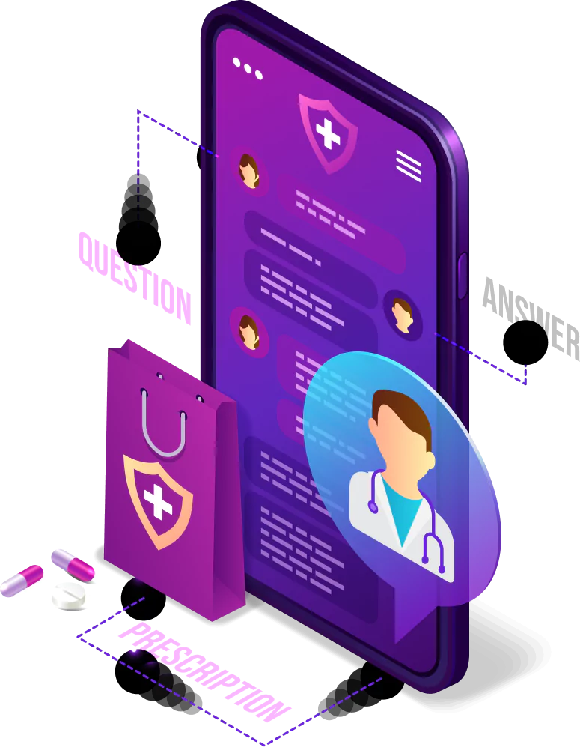
SpeedyDoc
Conclusion
SPEEDY
DOC
In the face of Canada's healthcare challenges - from doctor shortages and long waiting times to bureaucratic hurdles - SpeedyDoc emerges as a transformative solution. By integrating advanced AI, Google Med-PaLM 2, SpeedyDoc addresses these issues head-on. It ensures swift, accurate, and compassionate care, bridging gaps in healthcare access.
The platform’s ability to connect patients Global Doctor Network (Canadian-Asian Doctor Pair) facilitates cross-cultural insights and enhances the patient experience. Through detailed case studies, SpeedyDoc's impact becomes evident from rapid diagnoses of rare diseases to aiding emergency triage and optimizing chronic condition management.
SpeedyDoc stands as a beacon of hope, revolutionizing healthcare delivery and ensuring a healthier future for all.

Slide 21
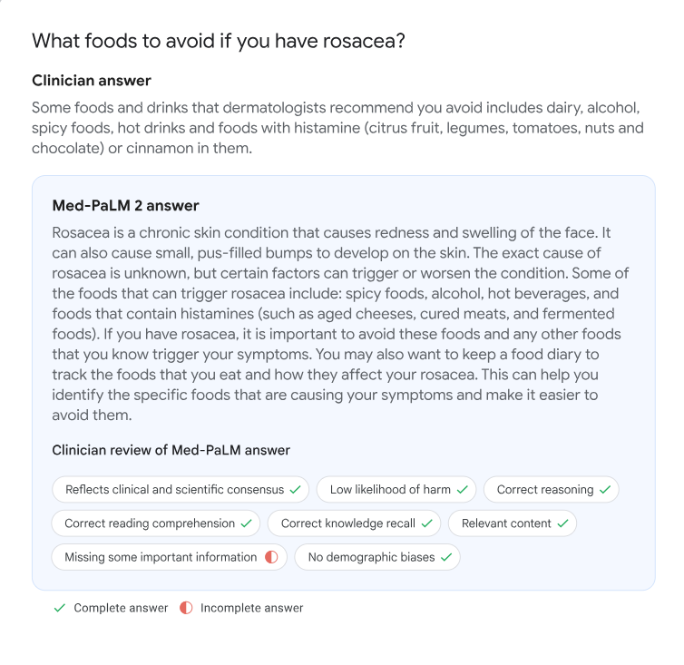
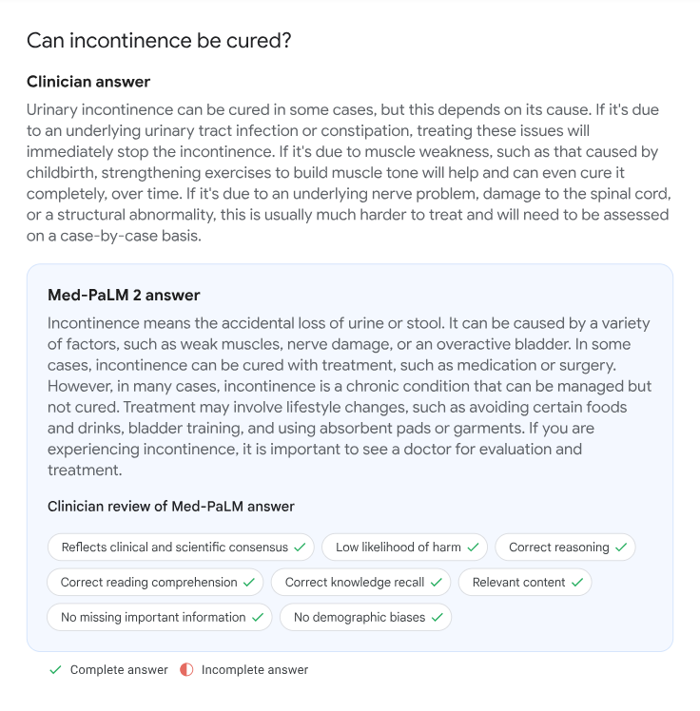
SpeedyDoc
Sample Clinical Answers
SPEEDY
DOC

Slide 22
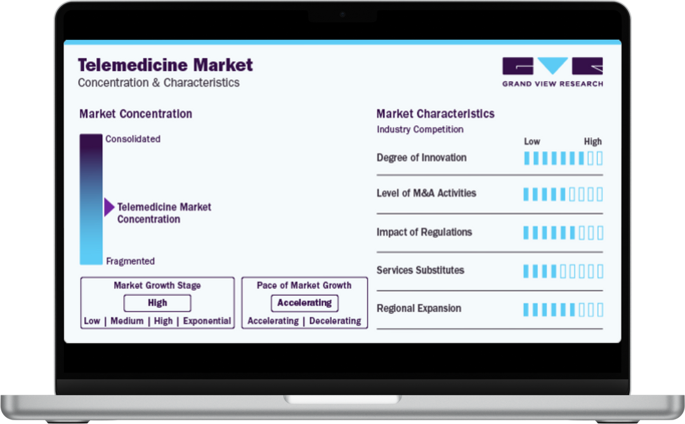
SpeedyDoc - Business Ap﻿proach
SPEEDY
Digital Health Market – Canada and the World
DOC
The global telemedicine market size was valued at USD 114.98 billion in 2023 and is expected to grow at a compound annual growth rate (CAGR) of 17.96% from 2024 to 2030 to reach USD 380.3 billion by 2030.
This growth is being driven by factors such as consolidation across industry, strategic initiatives by key companies, and increasing healthcare consumerism. Rising adoption of telemedicine by providers, increasing patient acceptance and consumer demand, and delivery of improved quality of care are expected to contribute to the growth of the market over the forecast period. SOURCE

Slide 23
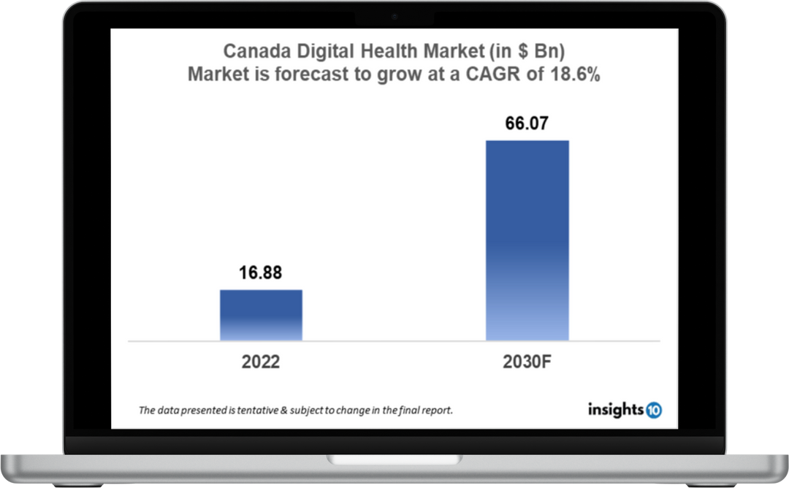
SpeedyDoc - Business Ap﻿proach
SPEEDY
Digital Health Market – Canada and the World
DOC
Canada's digital market size was valued at $16.88 Bn in 2022 and is estimated to expand at a compound annual growth rate (CAGR) of 18.6% from 2022 to 2030 and will reach $66.07 Bn in 2030. Source

Slide 24

SpeedyDoc - Objectives
SPEEDY
SpeedyDoc Company Strategy
DOC
Create new Web and Mobile Application for Users / Doctors.
Recruit and grow batches of Canadian and Asian Doctors and specialists for the teleconsultation.
Train and Improve data for better results .
Build Marketing & Business Development team to grow revenues.
Improve delivery and scaling of Application.

Slide 25

SpeedyDoc - INVITATION
SPEEDY
SpeedyDoc Opportunity
DOC
SpeedyDoc has the depth and ability to expand our AI/ML program.
SpeedyDoc has the depth and ability to expand our AI/ML program.

Slide 26
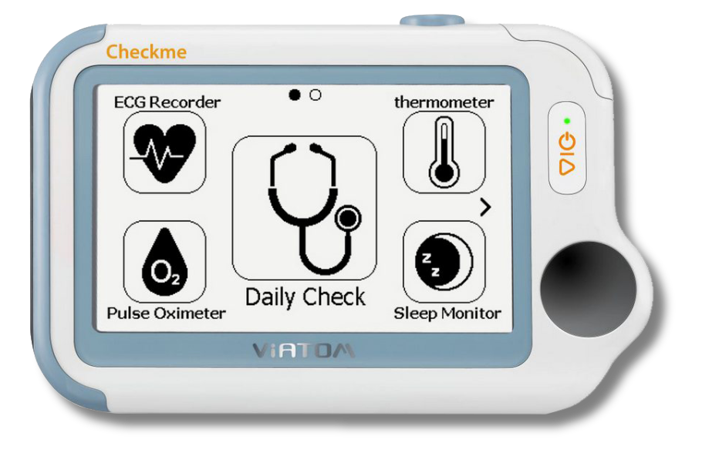


SpeedyDoc - Business Ap﻿proach
Business Model & Revenue Share Opportunity
Credits:
Canadian Doctor Visits:
$1 = 15 Credits (15 Answers)
$10 = 200 Credits (200 Answers)
$15 = 300 Credits (300 Answers)
Starting at $64.99 per visit or $24.99 per month (paid annually) for 25 Visits in a year.
Asian Doctor Visits:
Starting at $20 (paid annually) for 50 Visits in a year
Credits can be carried forward upto 12 months.

